Slide 1
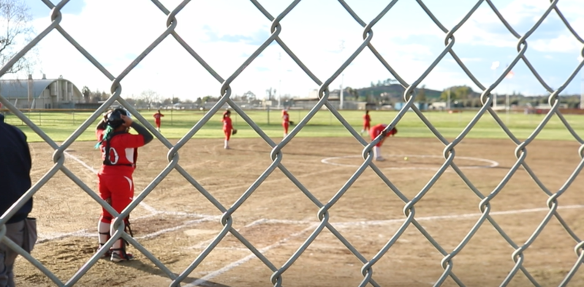
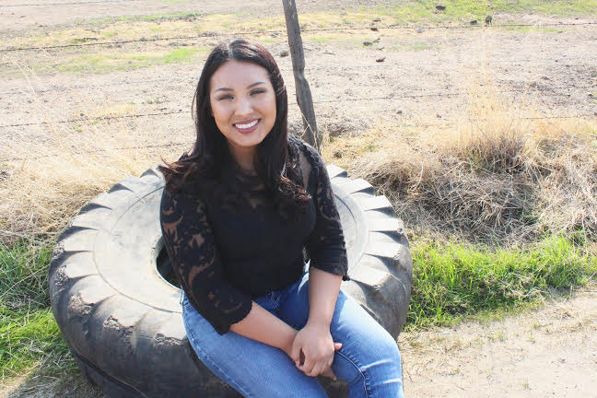
SKARLETT CAMPBELL-ROJAS
THis is who i am

Slide 2
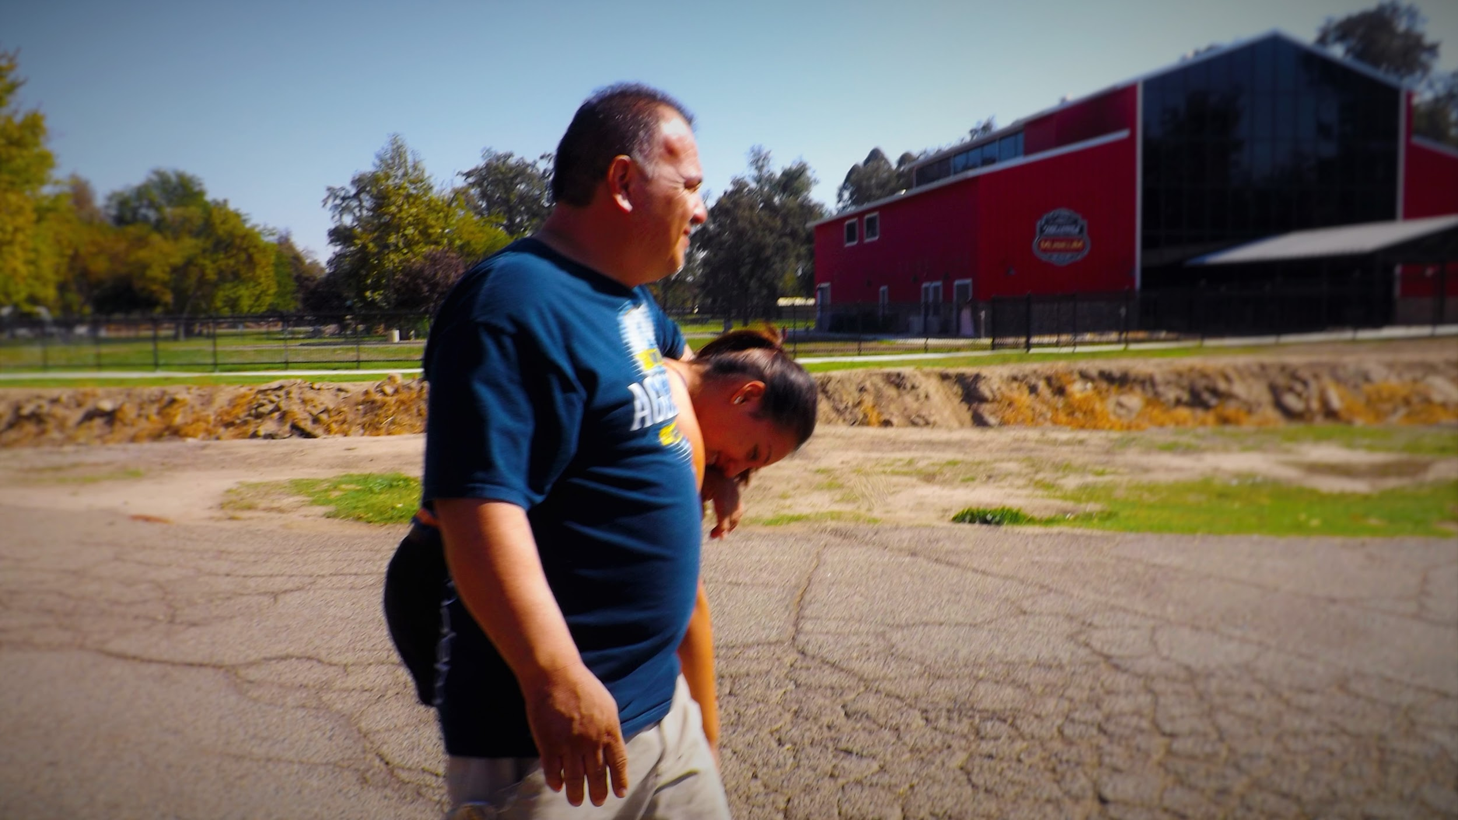
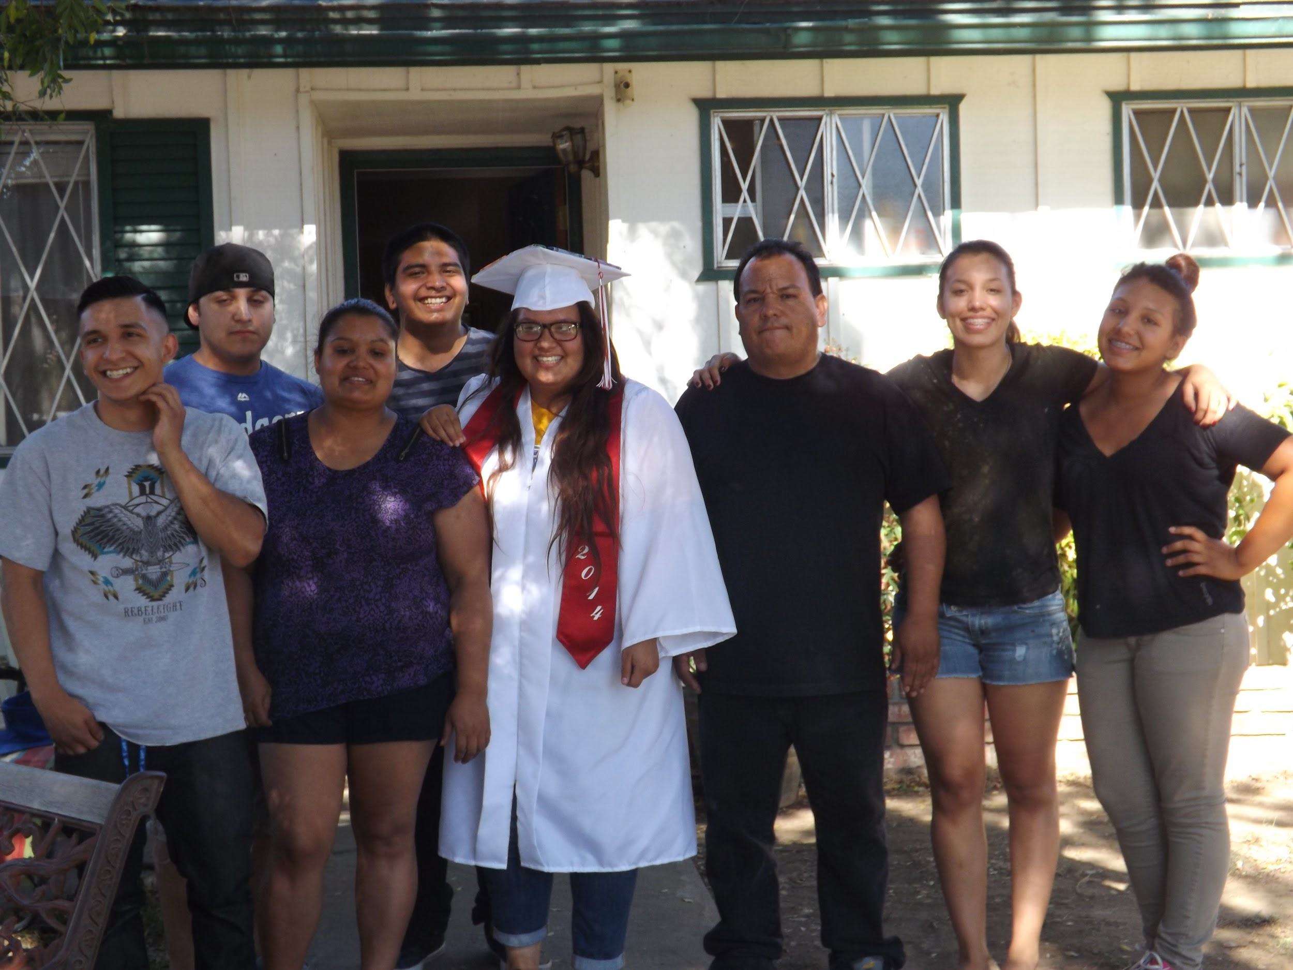
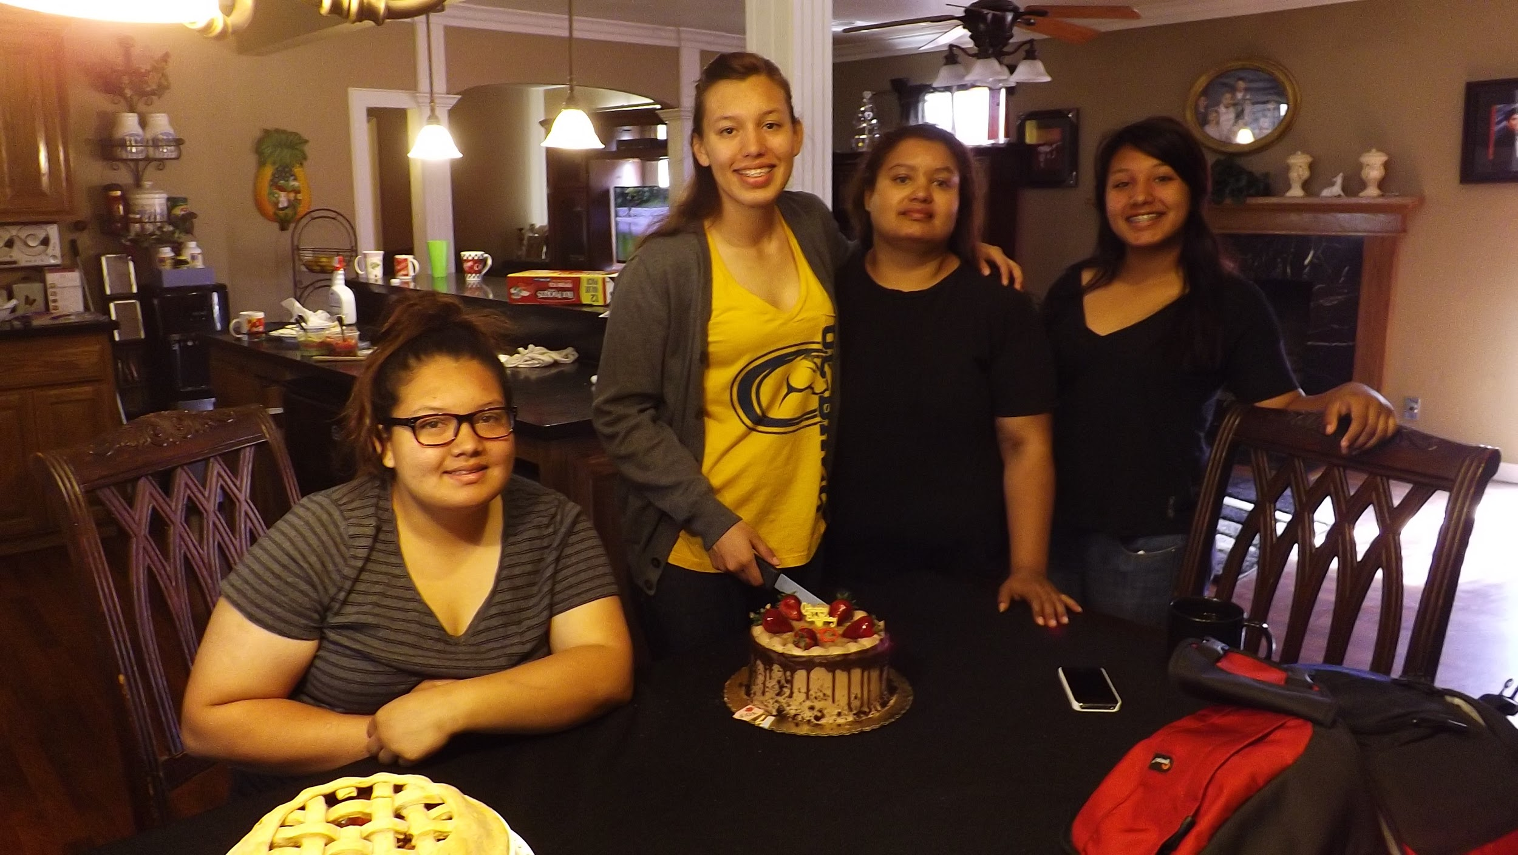
WHo AM I ?
I am 18 , Moved to Lindsay as a child
Three brothers , Two Sisters
FAMILY ORIENTED

Slide 3
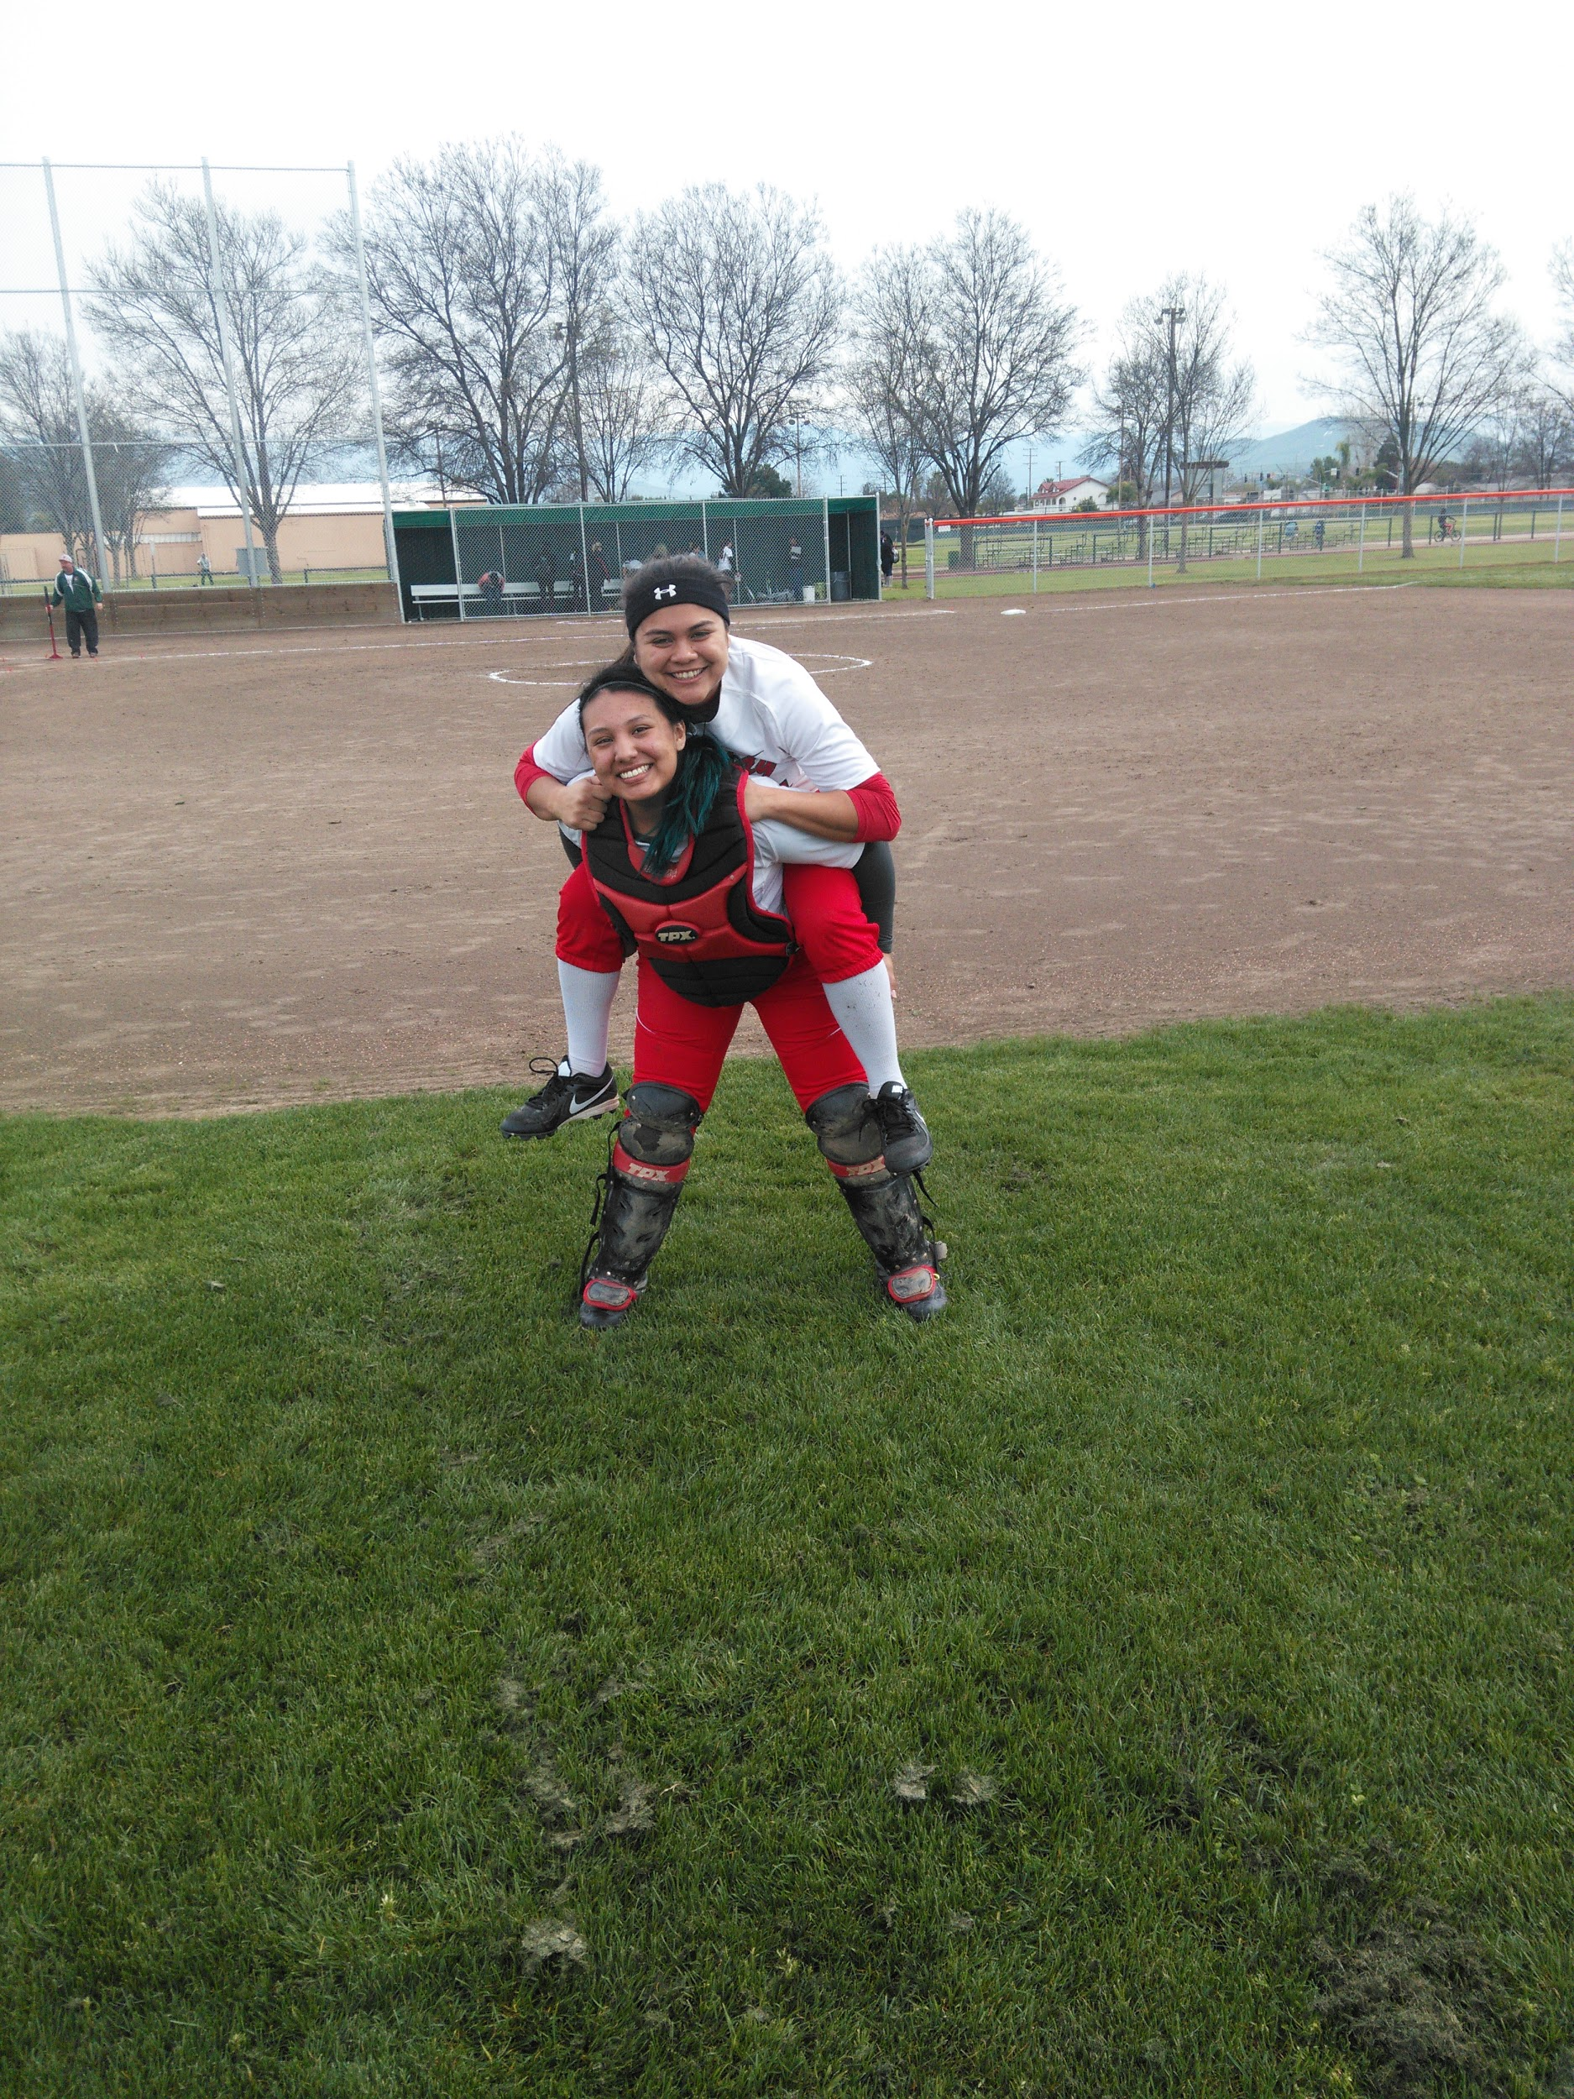
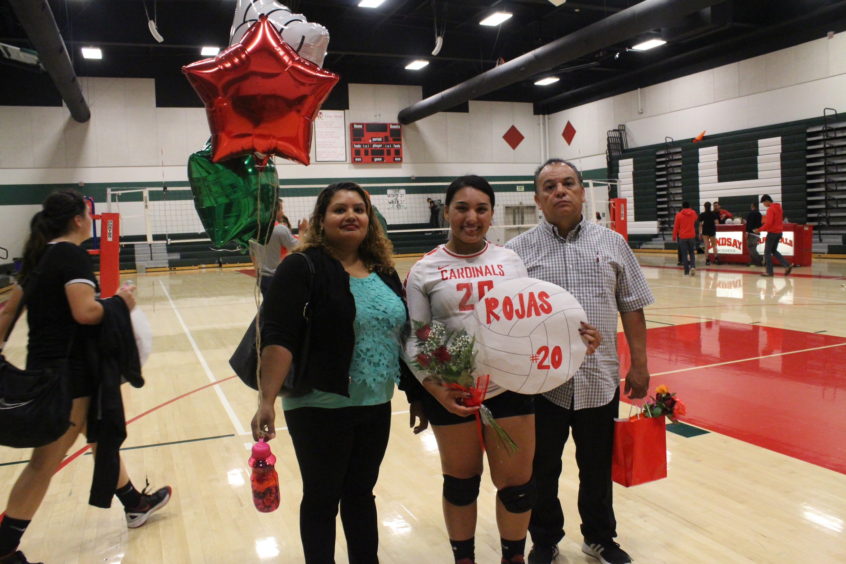
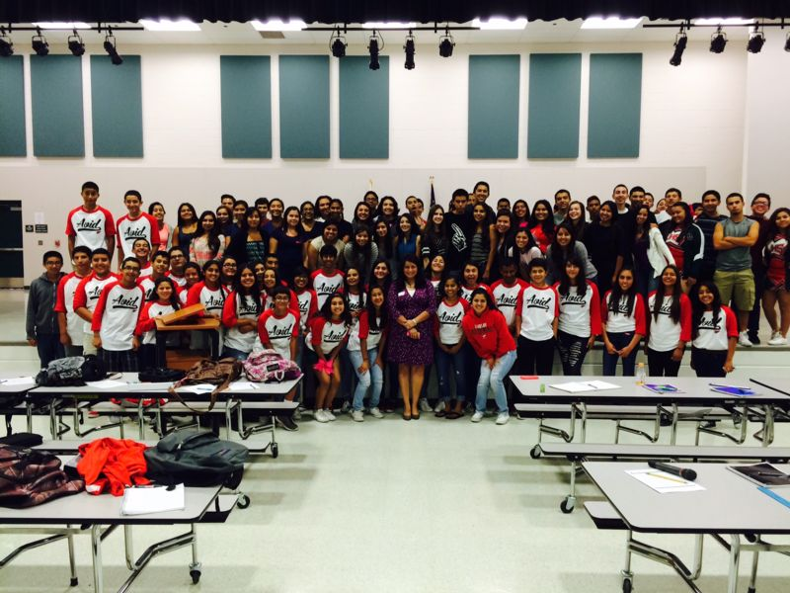
High school experiences
Clubs : AVID , FBLA , ASL , Adventure club , Art club , Block L
Personal changes : “Adultified-myself” , Less reliant on teachers
Apart of Varsity softball for all four years of high school
Apart of Volleyball for three years
Struggle: Learning to put myself first and to never let anyone say that what i believe in is wrong

Slide 4
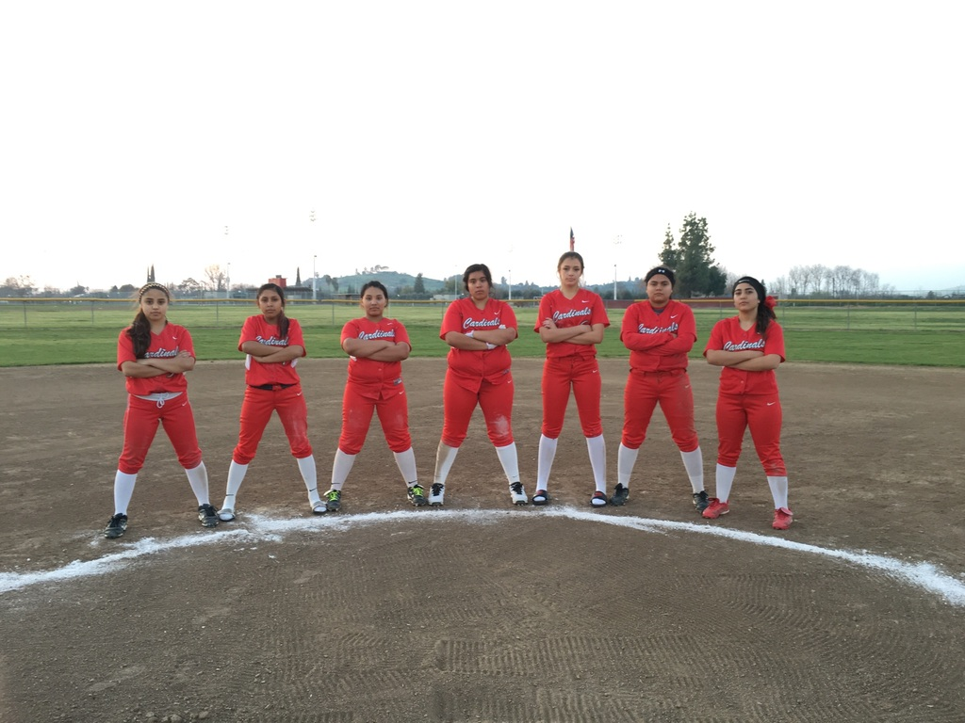
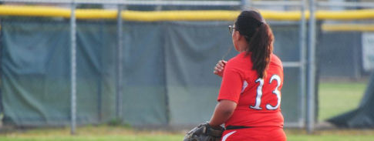
Softball ...
It can either make or break you
Go with the flow and no matter what is hit at you someone is there to have your back
Trust is KEY
Believe in your team and yourself
Not alone no matter what

Slide 5
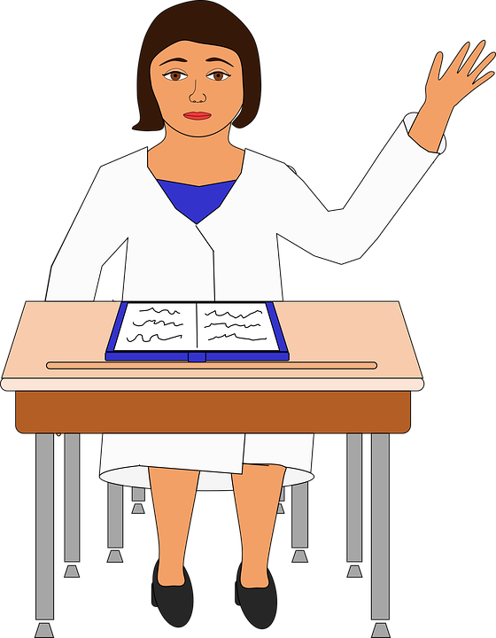
I Job Shadowed a Teacher
WASN’T ABLE TO job shadow radiologist due to privacy rules
Disappointed but Teaching is always a good backup
Being better with children
Lots of patience
Fun Fact : Kids Thought I was the Substitute

Slide 6
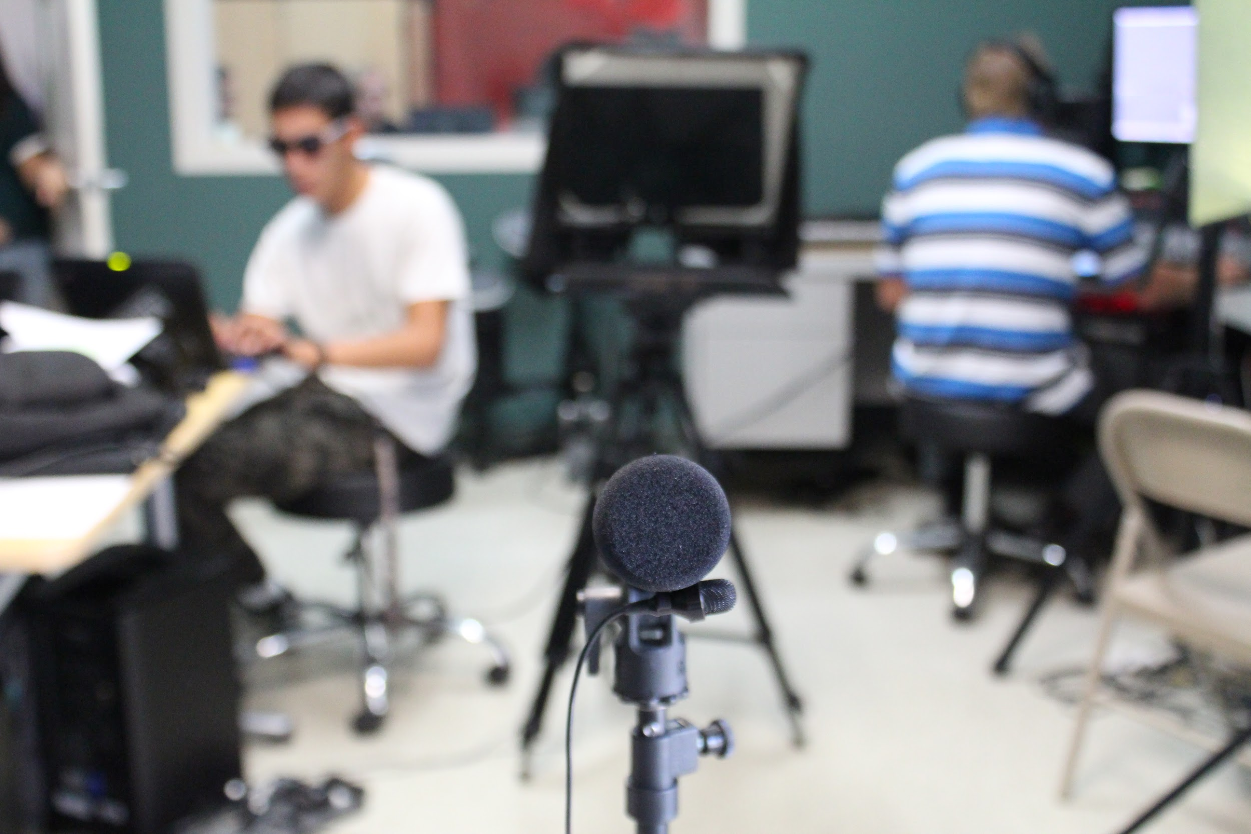
Multi- media Productions
Surprised by how much I enjoyed the class
Loved technology - taught me how to use it better
Apart of morning announcements
Filming
Skits
Teacher interviews
Student interviews
Entered a Film Festival
Indi comedy challenge

Slide 7
Pathway-Spanish Why I wanted to learn It...
Will let me interact with patients in the future
Spanish is becoming universal
Gives me an edge on other applicants for jobs
Writing and Reading the language came very easy
Never was able to speak to a large part of my family
Never knew spanish
Speech impediment
Now I am able to keep up with my family

Slide 8
After high school Plans...
Option Two ...
Option One ...
Sign with Voorhees College in South Carolina - Play softball for them
Major in criminal justice - minor in criminology
Move back to california - become a California Highway Patrol officer
Attend San Francisco State
Major in Diagnostic Radiology
Get my bachelors in Diagnostic Radiology , then masters
Go to Medical School
Get hired by a hospital in california
Get internship , then be asked to stay as a resident at that particular hospital

Slide 9
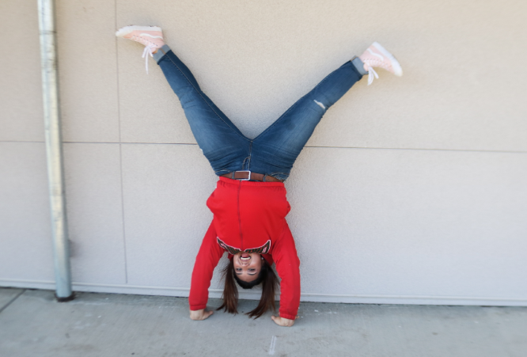
ANY QUESTIONS?

